Slide 1
Lessons Learned MDCRC 6200: SR/MA
Brian Locke MD MSc
Assistant Professor, Academic Track
Shock Trauma ICU, Schmidt Chest Clinic
Intermountain Medical Center
Aug 20, 2024

Slide 2
Objectives
Walk through the timeline of our project (MDCRC 6200 ‘22)
Discuss considerations for topic choice
Discuss some things that went well (& not) with our team
Highlight pitfalls
Open discussion/brainstorm

Slide 3
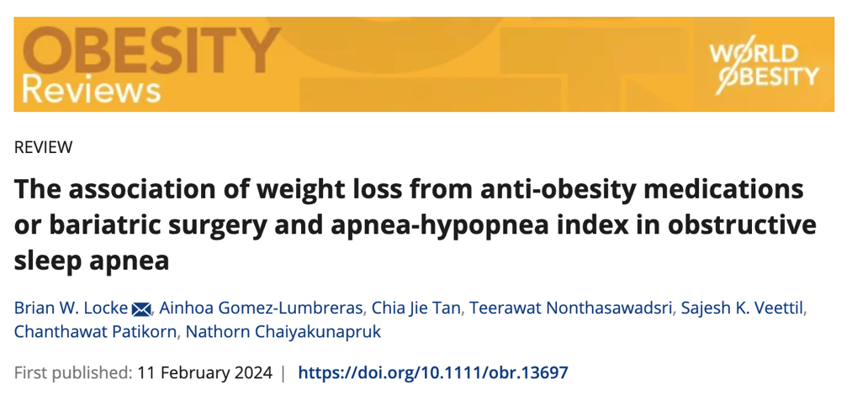
Aim to publish your stuff!
It’s bad [science] to abandon partly completed SRMAs
Get [career] credit for the time you spend
You’ll learn the most by making the project ‘publication quality’
There are venues for all types of project – just scope it correctly
Group of 3 (Tee, Ainhoa, Myself) – rest of TA’s contributed, especially CJ after course completed.
Notes:
We ended up going all in on a big project – but I think it’d be better to execute a smaller project than to only get half-way through a big one.

Slide 4
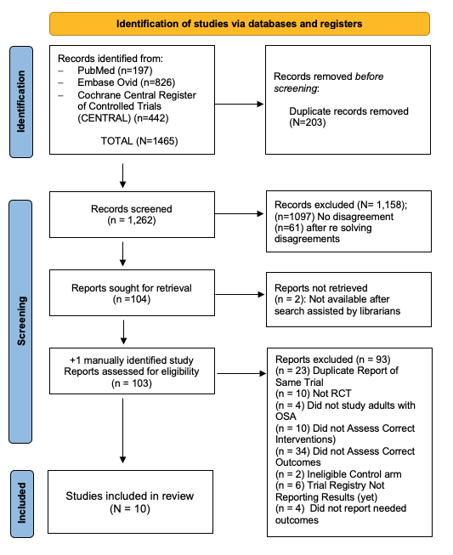
Topic Choices
Hypercapnia & Weight 1 study
Limited by the literature
Prevalence of OSA in ICU boring
Need group enthusiasm
OSA & Weight Loss?
GLP-1RAs → Meds → Meds & Surg
Initially, only found 3 studies
Ultimately found 10 (trial registers!)
→ Gap: little direct evidence on new weight management options (GLP-1s) & OSA
Notes:
You can’t systematically review a literature that doesn’t exist
You can’t do the project alone
Some of the additional finds were with better searches with the help of the librarians, and from different team members searching for related terms.

Slide 5
Our PICO(T): RCTs involving…
Patients: adults with overweight or obesity and who have OSA
Intervention: either an anti-obesity medication (FDA approved or not) or bariatric surgery.
Comparison: placebo, no treatment, or usual care (including CPAP or lifestyle modification).
Outcome: change in Apnea Hypopnea Index (AHI)
(Time): at least 4 weeks duration
Question: How much heterogeneity in AHI change is explained percentage weight change between randomization and last follow-up
The real (50 million * $3,000/yr =) $150 billion question: Will tirzepatide treat OSA?
Notes:
140 million americans are obese.
37 million have a diabetes indication
(Weight management not covered by Medicare by law)
Leaving ~100 million without an indication for insurance to cover
~50 million with OSA and obesity (of 80 million with OSA)? -> Eli Lilly has now asked the FDA to approve for OSA: billions in the balance. $3000/yr

Slide 6
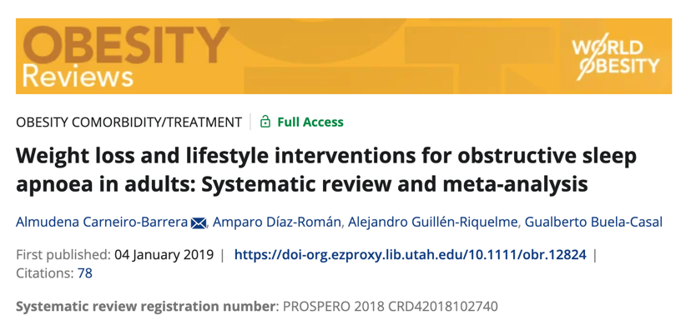
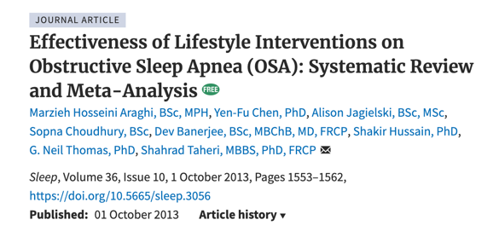
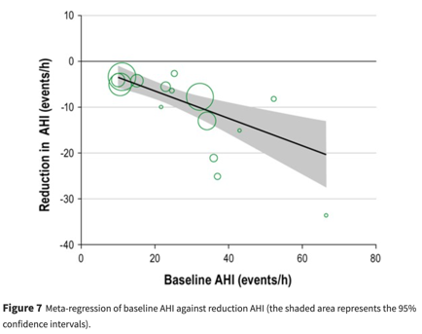
Strengths of our Topic:
Emerging field (GLP-1 RA’s!) with a knowledge gap
Able to quantitatively analyze
meta-analysis and meta-regression
3→10 RCTs (started borderline low, ended borderline high)
Similar analyses existed, but never our question & we had new studies
Notes:
What’s your edge?
-- consider, if it’s some huge topic, a big experienced research group with an army of research assistants can do much quicker / better
Similarly advanced statistical methods – will be hard to do a comparatively good job vs. experienced statisticians.
Maybe better:
New angle on a question?
Emerging topic?

Slide 7
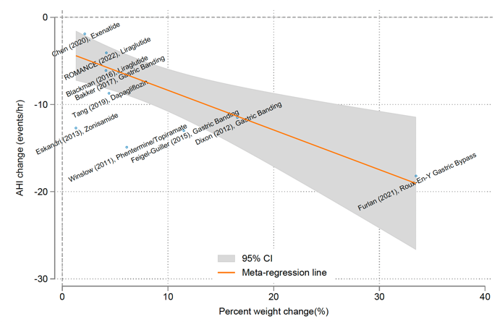
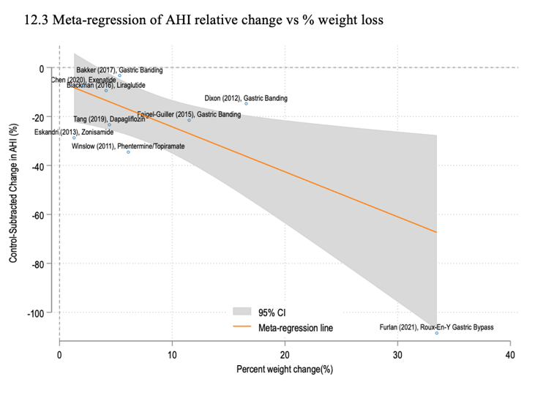
Weaknesses of our topic
Many ongoing trials
Short window before needing to redo
Pressure with other SRMA groups
(also, indicates of a good topic)
Meta-regression: more nuanced*
Be careful with complex analyses
Expertise, reviewers, etc.
(but, enabled addressing a gap)
Notes:
Trouble with complex methods: it adds lots of complexity, it makes it harder to review (and the people who know how to review are likely to be harsh)
Note: we intended to use R^2 to summarize how much of the heterogeneity in change in AHI could be attributed to weight – but it turns out this requires a fixed/common effect meta-analysis to interpret in the simple way, and we felt that a mixed effects MA was more appropriate due to the many other sources of variability = tough interpretation.

Slide 8
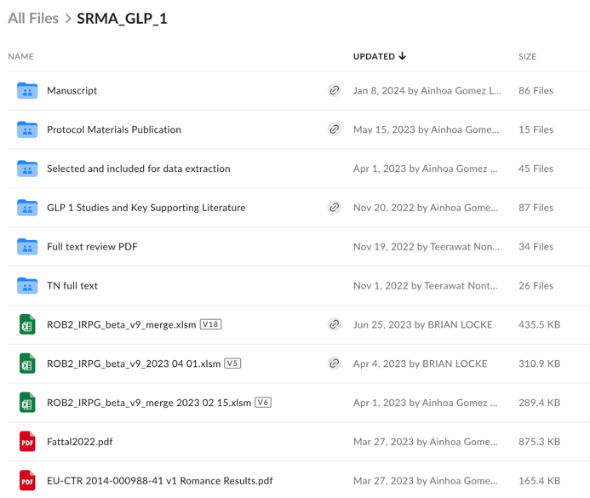

Strengths / Weaknesses of our team
Mix of interests and strengths
Defined roles: methods & subject matter, metabolic research, systematic review expert, etc.
Organization:
we used a shared box (discuss conventions)
ultimately github for the code: https://github.com/reblocke/AOM-and-Bari-Surg-for-OSA-SRMA

Slide 9
Timeline
The class deadlines come fast
Sessions are more useful the more you’ve done.
Polished > Rough >> Nothing
Objectives build on each other
Don’t fall behind early!
Date | Topics
Week 3 09/03 | Ignite #1 – Research proposal presentation
Week 6 09/24 | Ignite #2 – Search/screening presentations
Week 10 10/29 | Ignite #3 – Data extraction, study characteristics, and prelim results
Week 13 11/19 | Ignite #4 – Prelim Findings & Abstract
Progress will be MUCH slower once the class finishes.

Slide 10
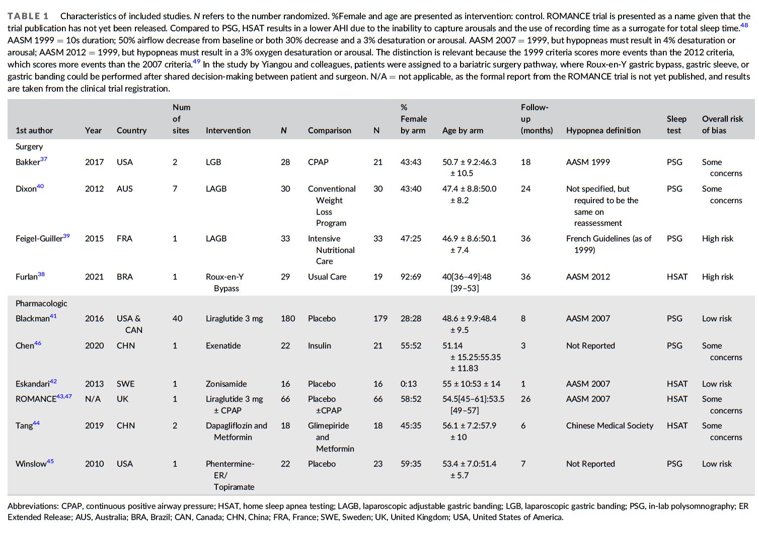

Slide 11
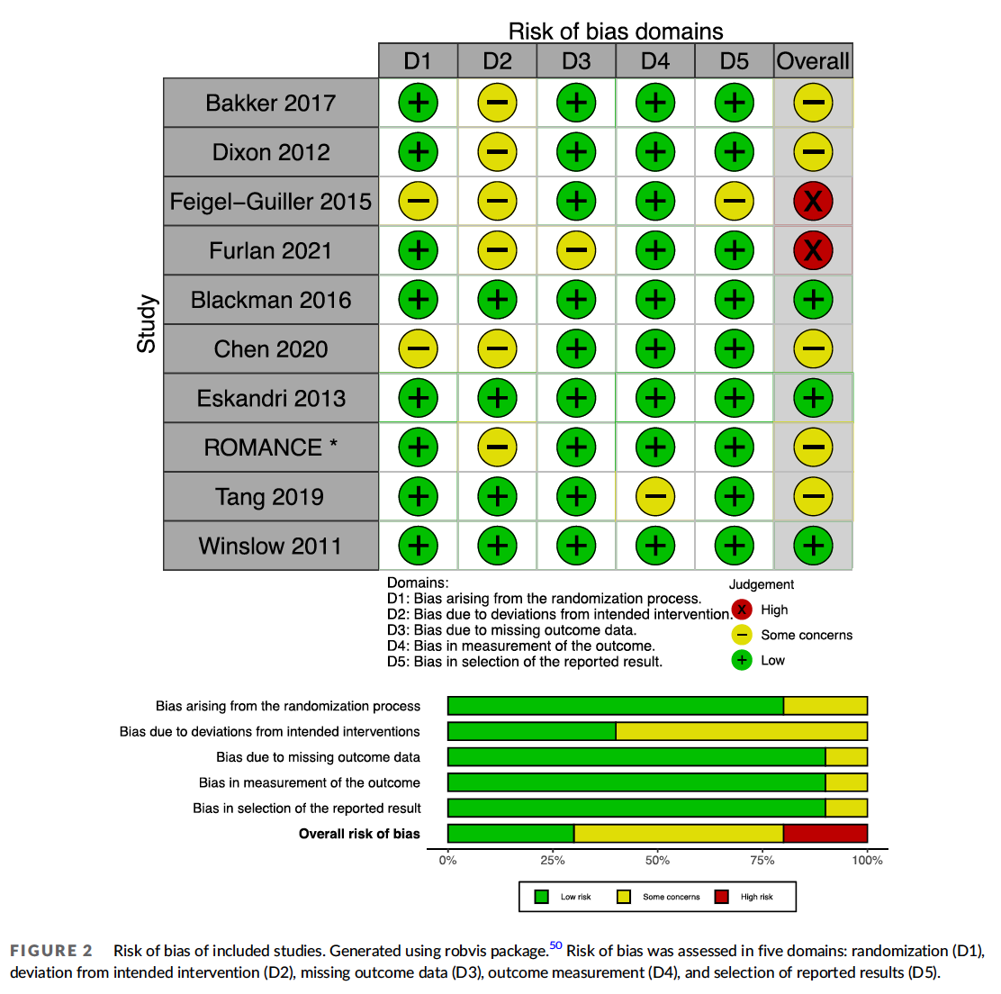

Slide 12
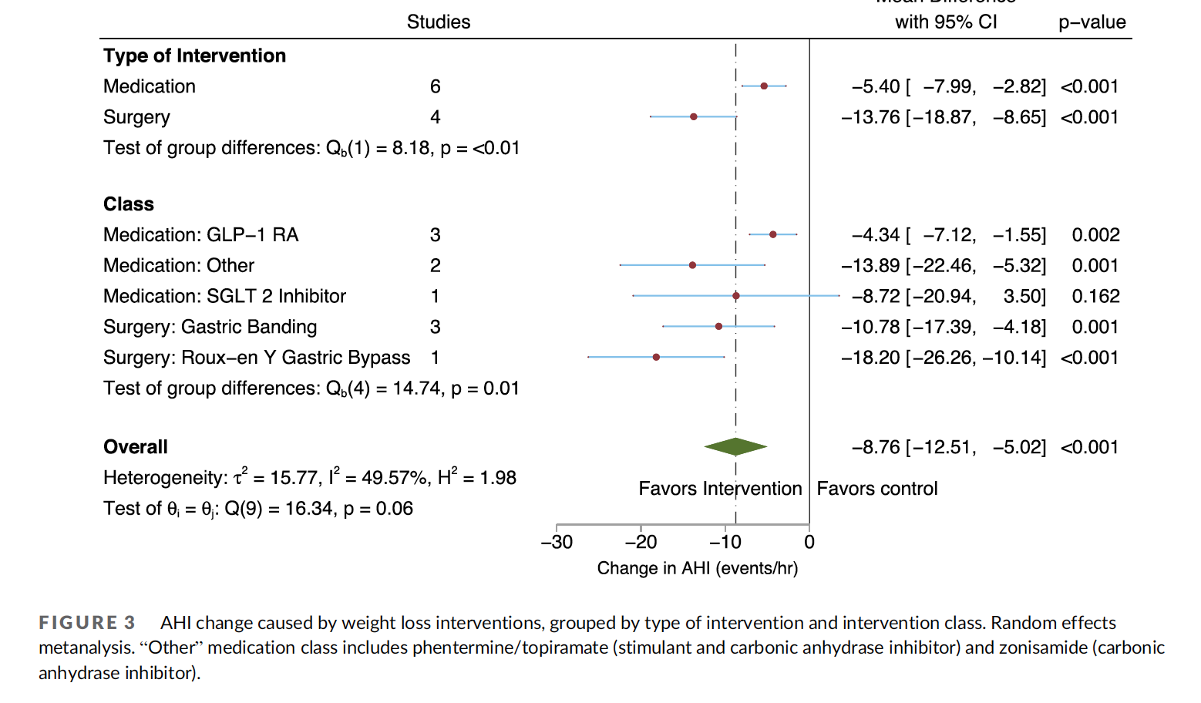

Slide 13
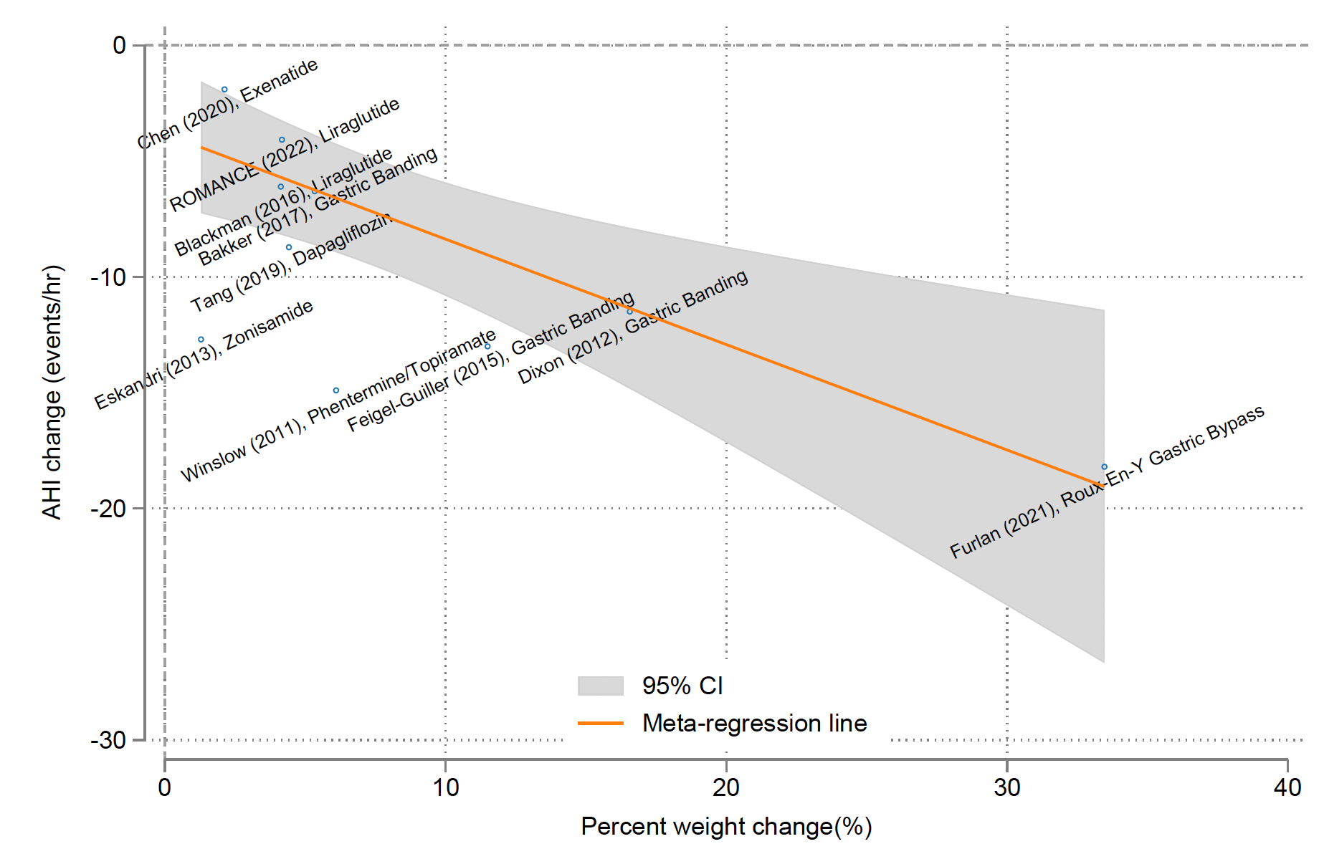

Slide 14
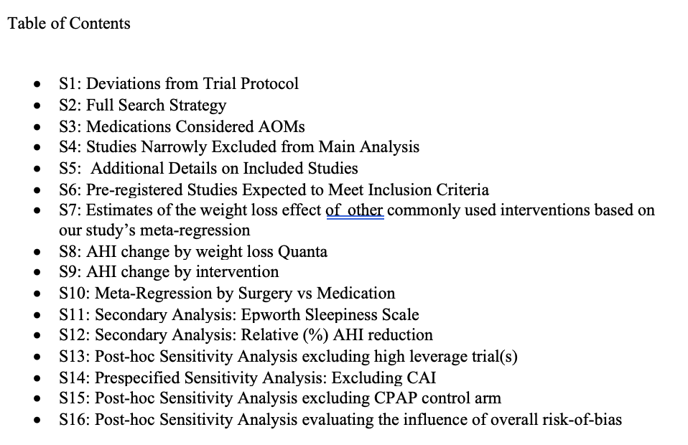

Slide 15
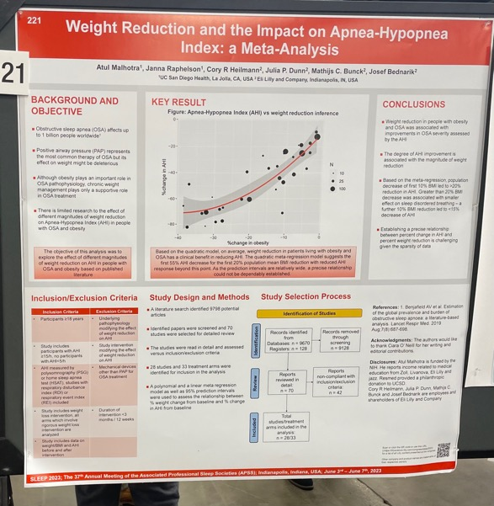
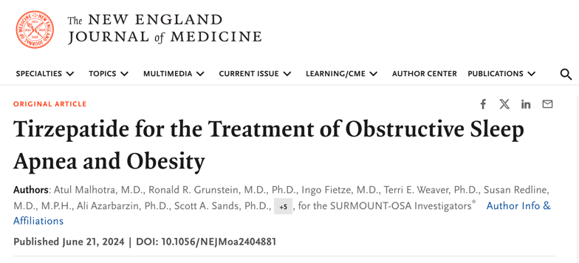
Our Progress:
Completed draft Dec 2022
Fine-tuned methods/figures & back-and-forth data requests from borderline includable studies* until June 2023
Submitted ➞ Reject from JAMA Network Open June 2023
Submitted to Obesity Review – July 2023
Revisions – Sept to Oct 2023
Accepted Dec 2023
Published Feb 2024
Notes:
This took a long time to do – and was definitely the right thing – to ask authors for needed data: but is somewhat challenging because it’s easy to burn a lot of time waiting for responses.

Slide 16
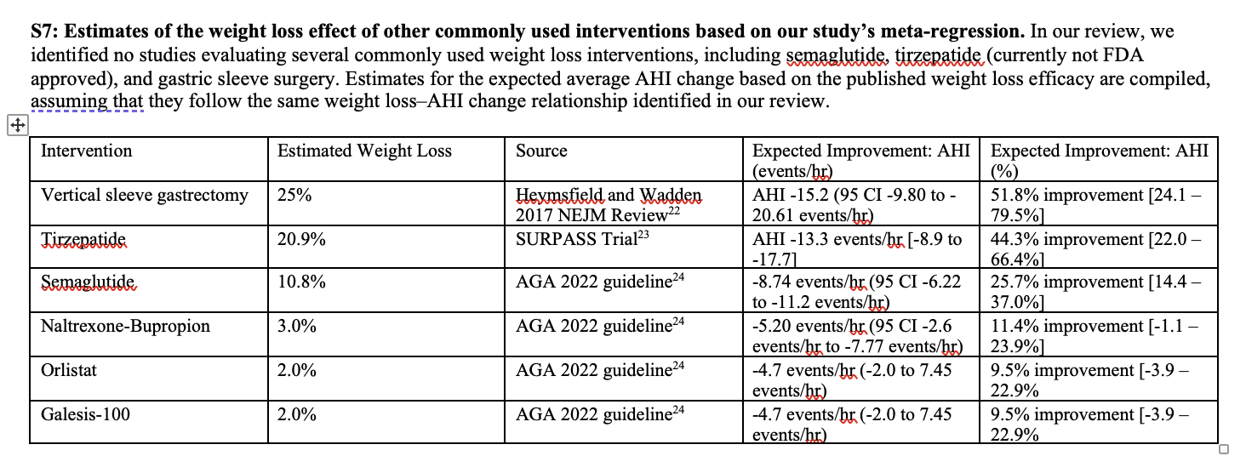
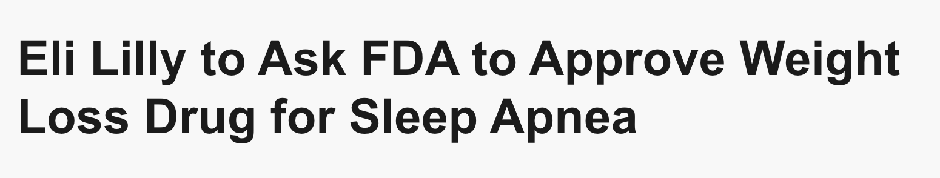
Our Progress:
Completed draft Dec 2022
Fine-tuned methods/figures & back-and-forth data requests from borderline includable studies* until June 2023
Submitted ➞ Reject from JAMA Network Open June 2023
Submitted to Obesity Review – July 2023
Revisions – Sept to Oct 2023
Accepted Dec 2023
Published Feb 2024
Notes:
Almost certainly will get approval.

Slide 17
Takeaways:
Choose a topic where:
All group members are excited about the question
There is a literature to support the SRMA
It’s a hot topic
Project Execution
Use box or another shared drive to organize
Choose simple, quantitative methods if possible
Meet early deadlines
brian.locke@imail.org
Feel free to use my STATA code
(will make more sense after the STATA session)
Other SRMA recommendations:
Read related SRMAs to understand structure/framing
Keep the STATA template ready to combine studies you read about
(MA is fast but takes practice, SR is slow/methodological)
Notes:
Life’s too short to do a SRMA on a topic no one cares about

